Slide 1

DEPARTMENT OF COMPUTER SCIENCE AND ENGINEERING
Codegene - Skill Enhacement Project
CAMPUS LOST AND FOUND PORTAL
PROJECT STUDENT
VARSHA SRI M, 43110982

Slide 2
AGENDA
Abstract
Existing System
Proposed System
Advantages
Disadvantages
Hardware Requirements
Software Requirements
Modules
Module Description
Sample Output
Conclusion

Slide 3
ABSTRACT
The Campus Lost & Found Portal is a web-based system designed to simplify the process of reporting and retrieving lost or found items within a college campus. The platform allows students and staff to post details about lost or found belongings, including images, descriptions, and contact information. Administrators can manage user activities and verify posts to ensure authenticity. This system promotes efficiency, transparency, and convenience by providing a centralized digital platform that replaces traditional noticeboard-based methods.

Slide 4
EXISTING SYSTEM
The current process relies on manual methods such as:
1. Noticeboards
2. Word-of-mouth communication
3. Social media posts or group messages
These methods are unorganized and time-consuming.
There is no centralized record to track lost and found items.
Items are often never recovered due to inefficient communication.
There is no authentication or verification of claims, leading to misinformation and confusion.

Slide 5
PROPOSED SYSTEM
The proposed system introduces a digital, automated portal for managing lost and found items within the campus.
Users can:
Register and log in securely.
Post, view, and search for lost and found items easily.
Edit or delete only their own posts (student users).
Admins can:
Manage and verify all user posts.
Control system activities and ensure authenticity.
The system supports:
Image uploads for better item identification.
Responsive design for use on any device.
Faster and more reliable communication between users.
Ensures security, user-friendliness, and transparency in lost and found management.

Slide 6
ADVANTAGES
Provides a centralized online platform for managing lost and found items.
Reduces manual effort and time spent searching for items.
Allows users to upload images, making identification easier.
Ensures data security and authorized access through login credentials.
Admin control ensures authenticity of posts and prevents misuse.
Fully responsive design, accessible on both desktop and mobile devices.
Maintains records for all posts, making it easy to track and recover items.

Slide 7
DISADVANTAGES
Requires internet access for all operations.
Depends on accurate user input — incorrect details may delay recovery.
If the database is not properly maintained, data duplication may occur.
Limited to campus network or environment unless extended publicly.
Needs regular admin monitoring to verify and approve legitimate posts.

Slide 8
HARDWARE REQUIREMENTS
Any PC/Laptop/Smartphone with an updated browser.
Minimum 2 GHz processor, 4 GB RAM, 500 MB storage.
Stable internet connection (Wi-Fi or data).
Server setup or cloud hosting for Supabase backend.
Basic networking hardware (router/modem).

Slide 9
SOFTWARE REQUIREMENTS
1. Frontend:
HTML5
CSS3
JavaScript
2. Backend : Java (Spring Boot Framework)
3. Database: MySQL
4. IDE / Tools:
Spring Tool Suite (STS) or IntelliJ IDEA
MySQL Workbench
Web Browser (Chrome, Edge, Firefox)
5. Server : Apache Tomcat (Embedded in Spring Boot)
6. Operating System : Windows / macOS / Linux

Slide 10
MODULES
User Registration & Login Module
Admin Management Module
Post Lost/Found Items Module
Search & Match Module
Message/Communication Module
Database Management Module

Slide 11
Module Description
1. User Registration & Login Module:
Allows new users (students/admin) to register.
Students log in using their register number, while the admin logs in using a registered email ID.
Validates login credentials and grants access based on user type, Provides authentication and session management.
2. Admin Management Module
Admin can view, edit, or delete any post.
Has complete control over user accounts and all lost/found listings.
Can monitor activities and ensure only genuine posts are displayed.

Slide 12
Module Description
3. Post Lost/Found Items Module
Allows users to add lost or found item details (title, description, image, contact info).
Students can edit or delete only their own posts.
Automatically stores details in the database for easy retrieval.
4. Search & Match Module
Users can search items by keyword, title, or description.
Helps to match lost and found posts efficiently.
Displays relevant results instantly from the database.
5. Message/Communication Module
Enables communication between the finder and the owner through the portal.
Helps in verifying ownership before returning.
Keeps the communication secure within the portal.
6. Database Management Module
Handles storage of user and post data in MySQL database.
Ensures data consistency and integrity.
Supports CRUD operations — Create, Read, Update, Delete.

Slide 13
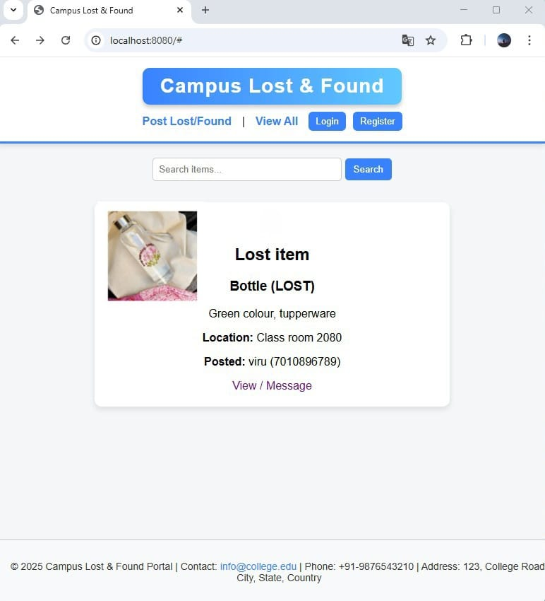
SAMPLE OUTPUT

Slide 14
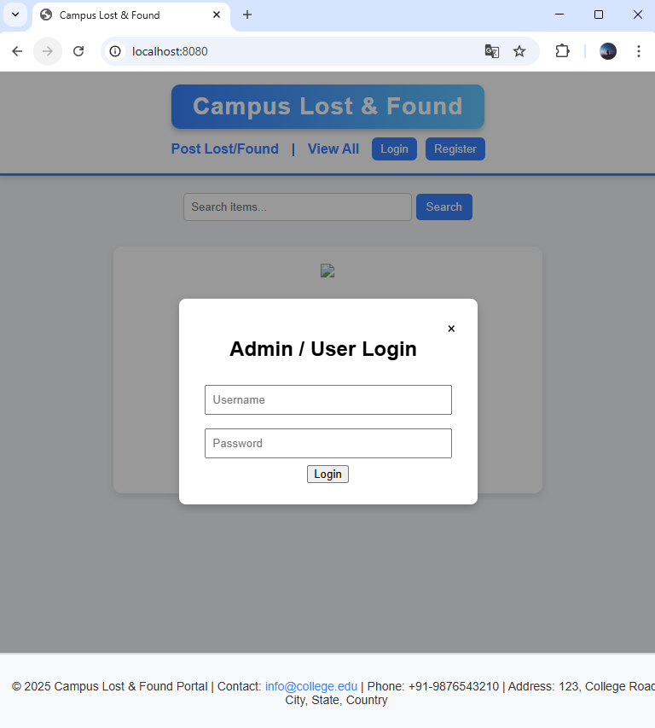
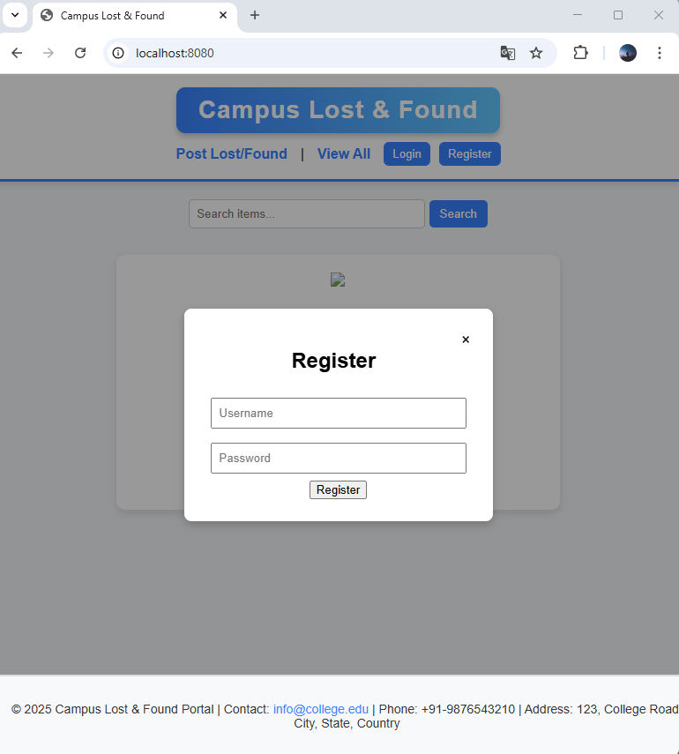

Slide 15
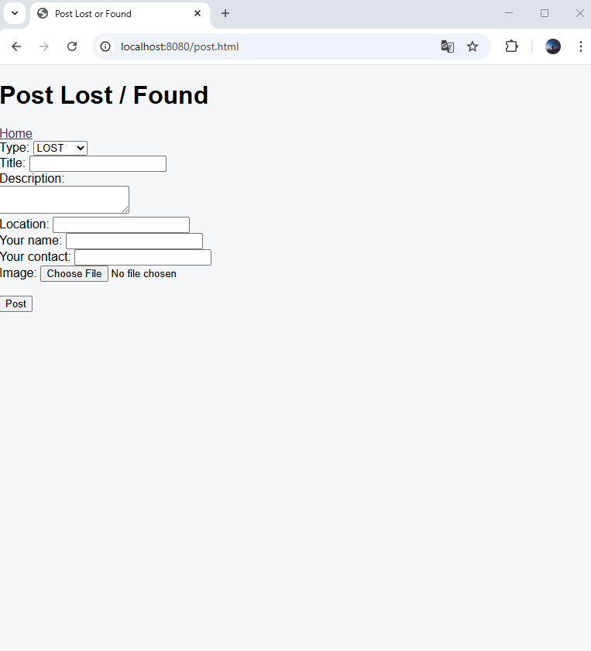

Slide 16
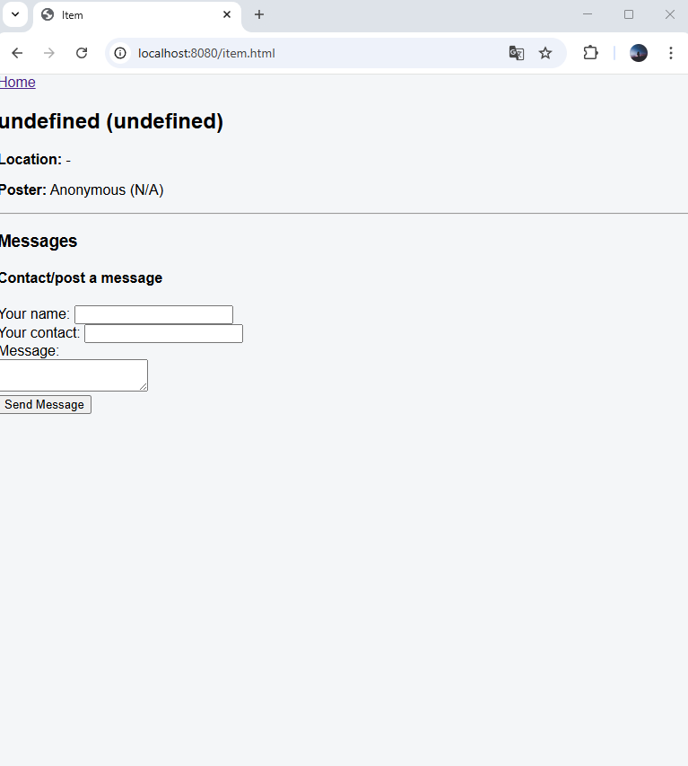

Slide 17
CONCLUSION
The Campus Lost & Found Portal provides an efficient, secure, and user-friendly platform for managing lost and found items within the campus.
It reduces time and effort, eliminates the need for manual announcements, and makes item recovery faster.
The system’s role-based access ensures that admins maintain control while students manage their own posts responsibly.
With its smart search and database integration, the project ensures better transparency, accessibility, and convenience for all users on campus.

